Slide 1
Slideshow projet 3 da python
2D game programming in python with pygame library

Slide 2
introduction
Macgyver stucks in a maze. He has to escape from it. Be careful though, a guardian is looking for you.
He has to collect three items and reach the guardian. If you collect 3 items, you win, otherwise you lose.
The purpose of this game is coding with an anticipation of its architecture and some constraints, also struggle and research !

Slide 3
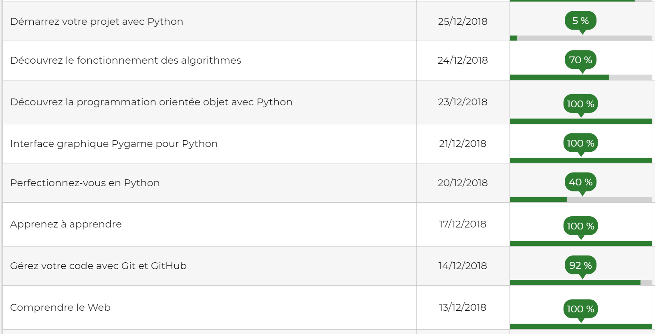
Courses taken (+ videos on youtube and google searchs)

Slide 4
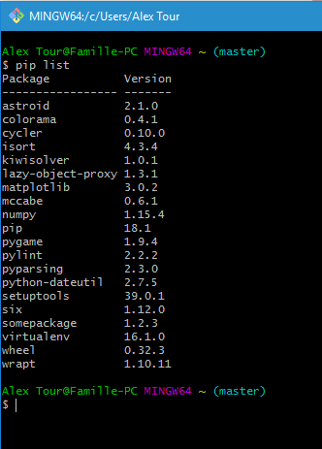
installation
Create a new repository on Github
Set Python 3.7, Pygame on windows 10
Execute python on Sublime Text with git
➔ Thanks to Google and Stackoverflow

Slide 5
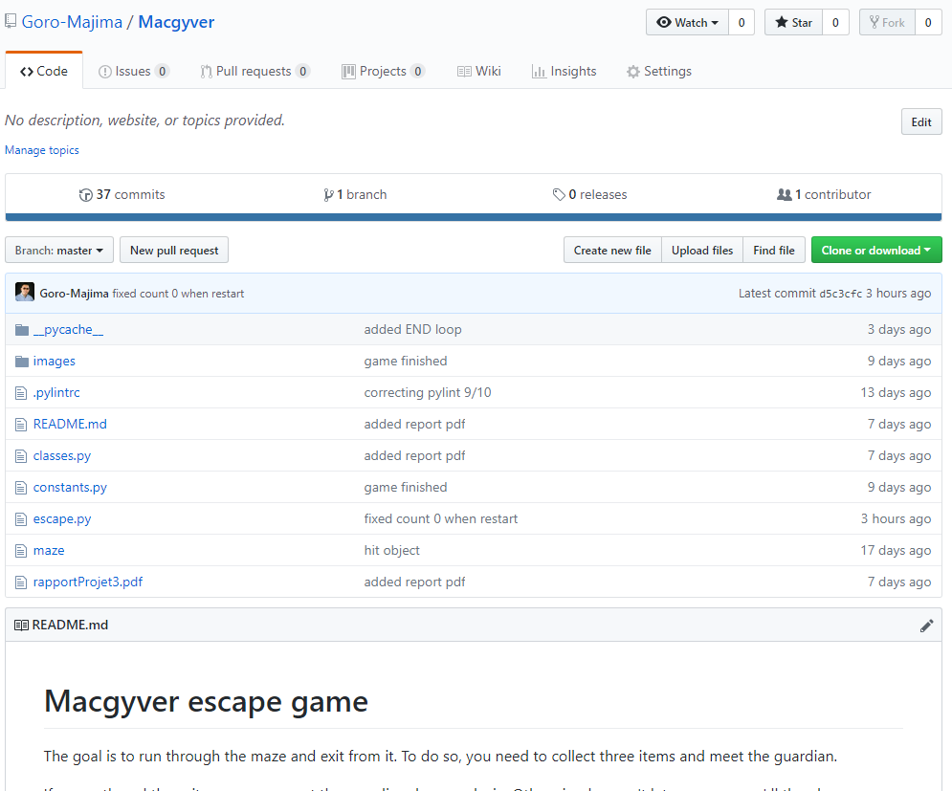
Github repository
https://github.com/Goro-Majima/Macgyver

Slide 6
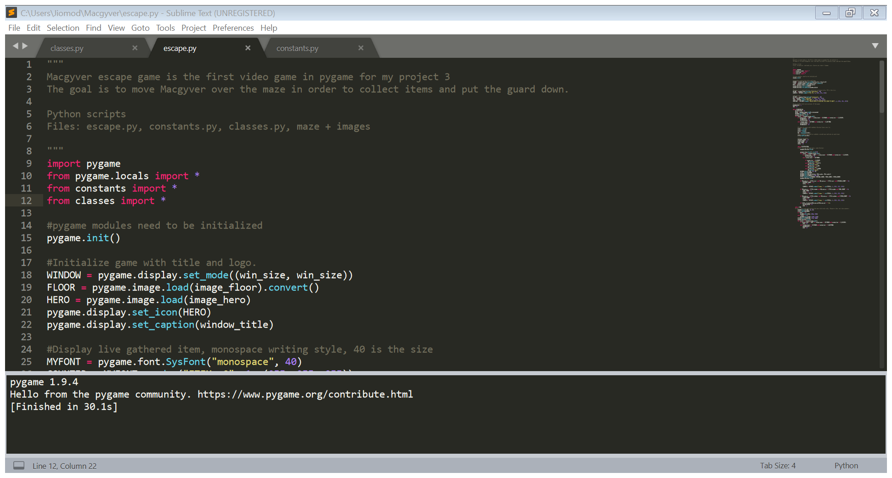
Project Structure:
Oriented object approach for a better organization of main, classes and constants.
Images such as characters, items and bricks are in a file « images ».
The maze is defined from a .txt file.

Slide 7
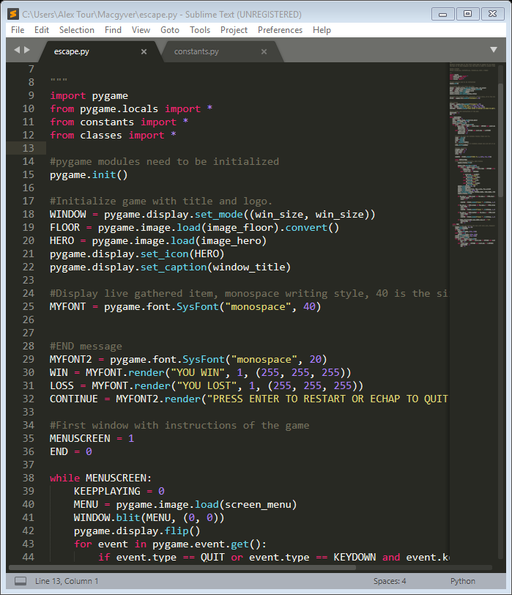
viewing image
Pygame functions (load, blit, display…) enable the upload and display of images and messages.

Slide 8
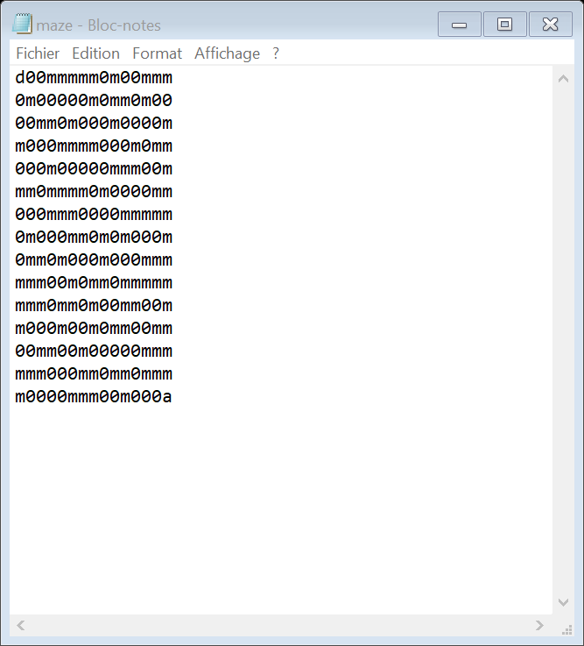
Maze structure
Draw a maze by opening a manually created .txt file and read through the path.
Definition of 15 *15 sprites (cells)
« m » is a brick wall
« 0 » is a the path
« a » is the finish.

Slide 9
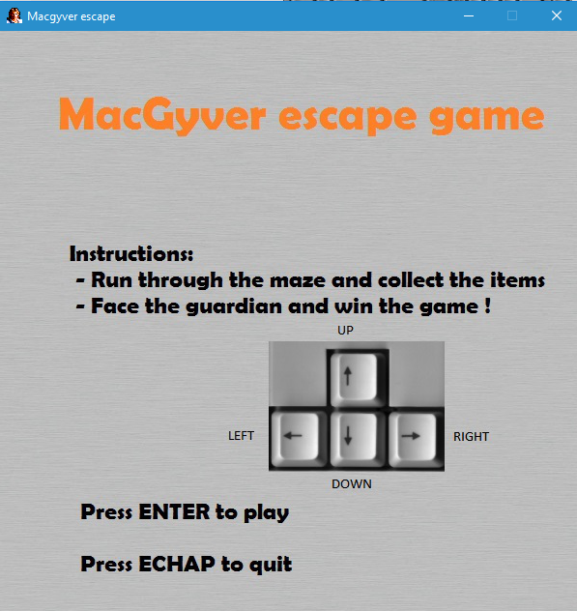
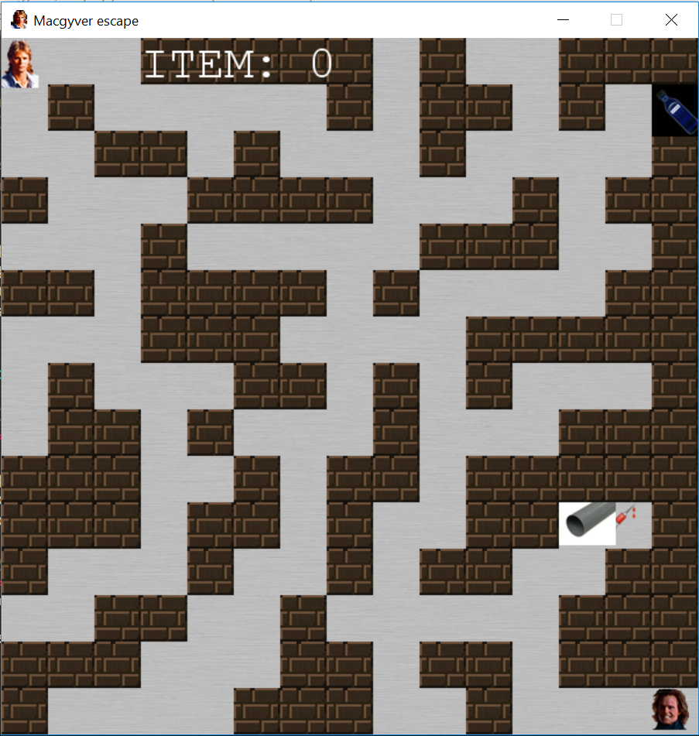
Generate the INSTRUCTIONS AND THEN GAME

Slide 10

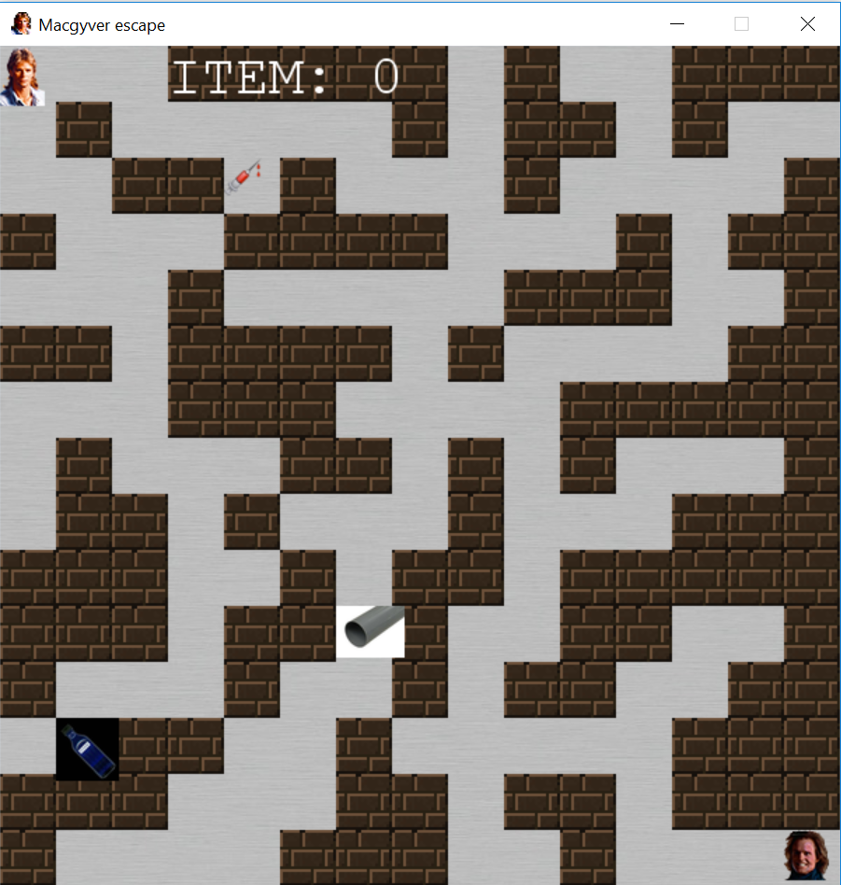
GOAL: ITEMS MUST BE ONLY ON PATH
imported Random library and function shuffle created
the function works: items never display over the maze and never superimpose

Slide 11
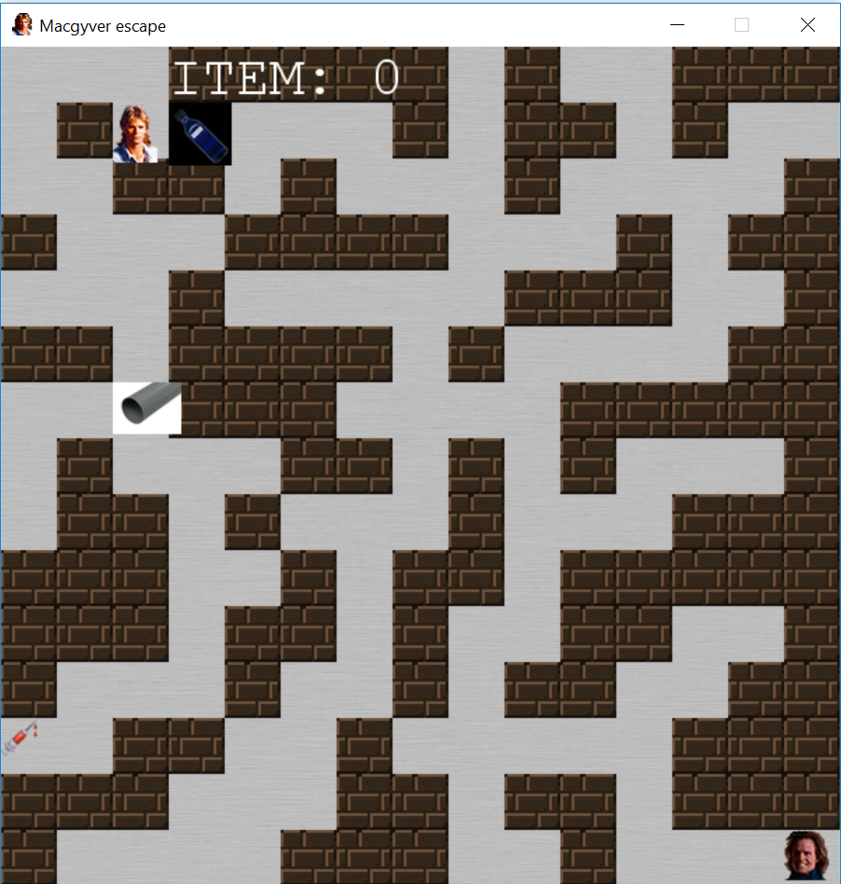
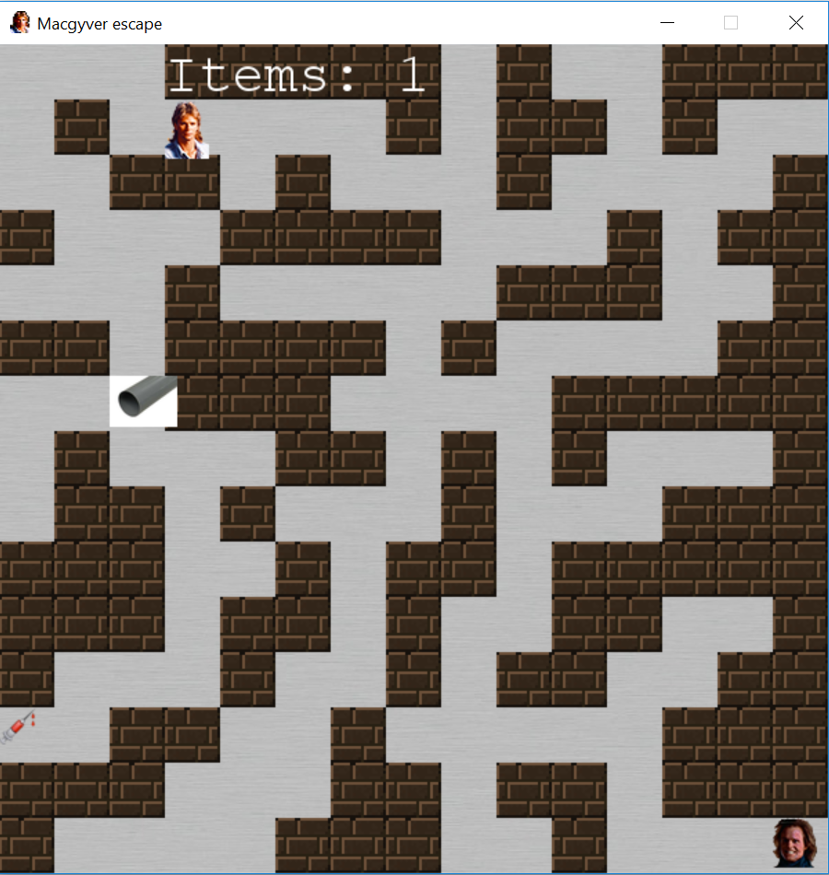
Macgyver only moves on path and can take item off maze and increment counter

Slide 12
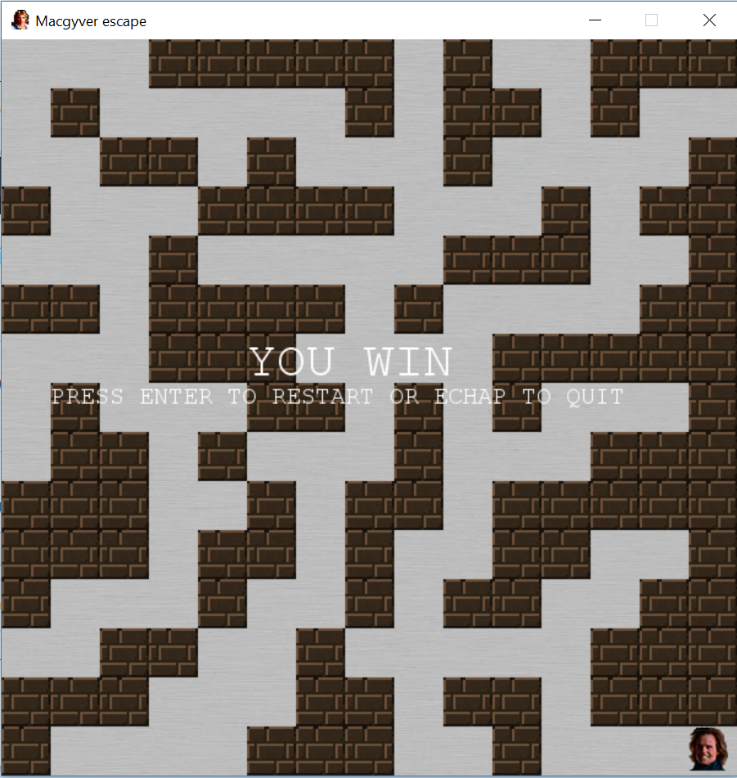
victory
Collect them all, go to the guardian position and win !

Slide 13
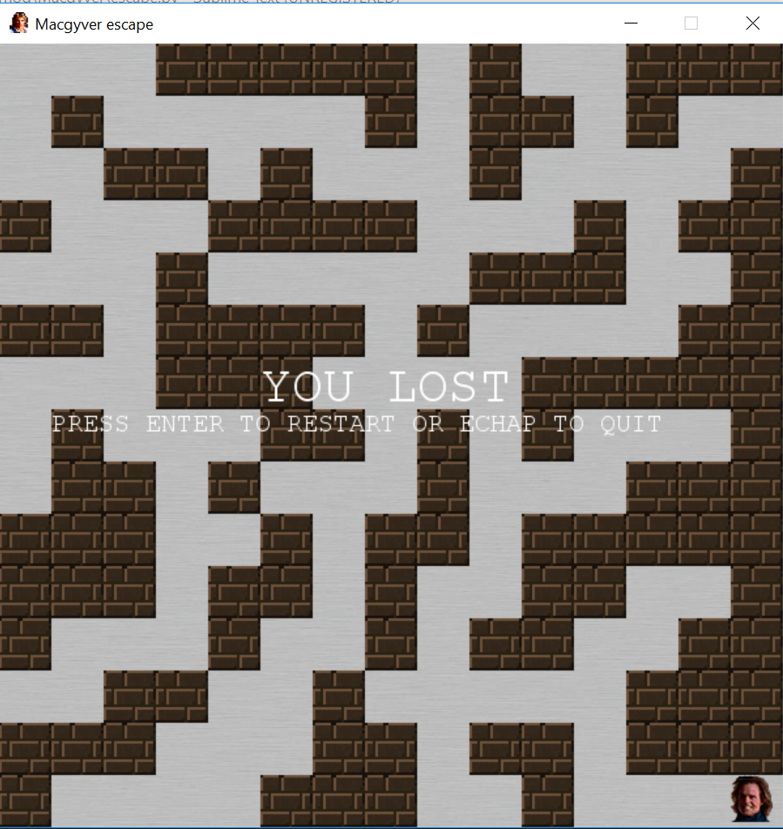
Other case
If less than three items are collected,
You LOSE.
In both case, you can either restart and be back to the instructions screen or leave the game.

Slide 14
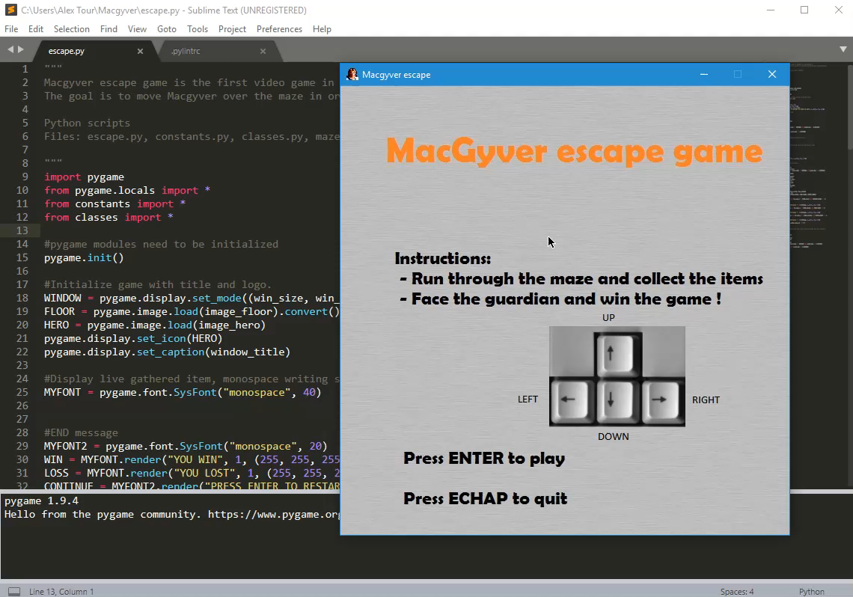
IN GAME SESSION

Slide 15
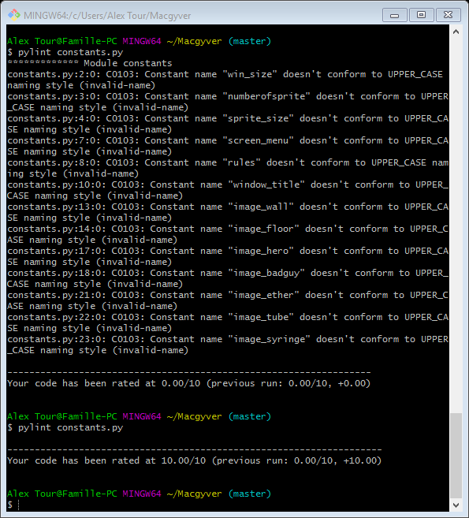
Python Code according to the style guide pep 8
Use of the software PYLINT to check source code based on PEP 8 recommandation. Some recommandations are ignored in order to make the code more readable.(.pylintrc)

Slide 16
How to enhance the game ?
Improving the graphics such as putting better icons of items and characters.
Adding moving ennemies
Adding features such as hitting ennemies and killing them
Create 2 levels of difficulty

Slide 17
Thanks for watching !
Any question ?

